Slide 1
Vidyavardhini’s College of Engineering & Technology
Department of Instrumentation Engineering
Subject : Applications of Microcontroller
Sem : V
Subject In-charge : Mrs. Kanchan Nehal Sarmalkar

Slide 2
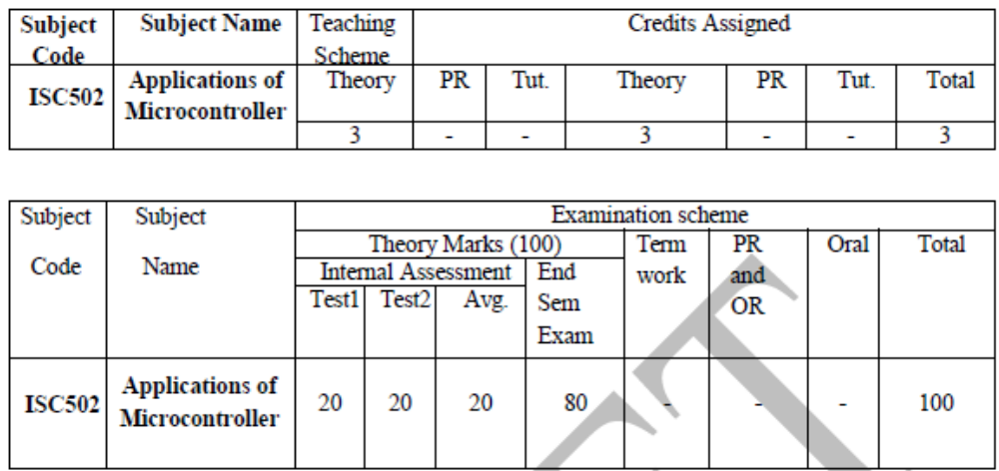

Slide 3
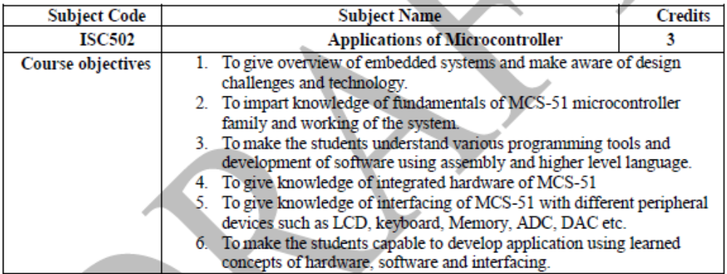

Slide 4
ISC502 | Applications of Microcontroller
ISC502.1 | Compare microprocessors & microcontrollers using embedded system technology.
ISC502.2 | Develop software programs using programming tools with the help of integrated hardware operation knowledge.
ISC502.3 | Create interfacing of peripheral components with MCS-51.
ISC502.4 | Criticize Case Studies of applications based on MCS-51 such as Data acquisition systems, Digital weighing machine, Washing machines, Traffic light controller, Frequency counter, Speed Control of DC motors.

Slide 5
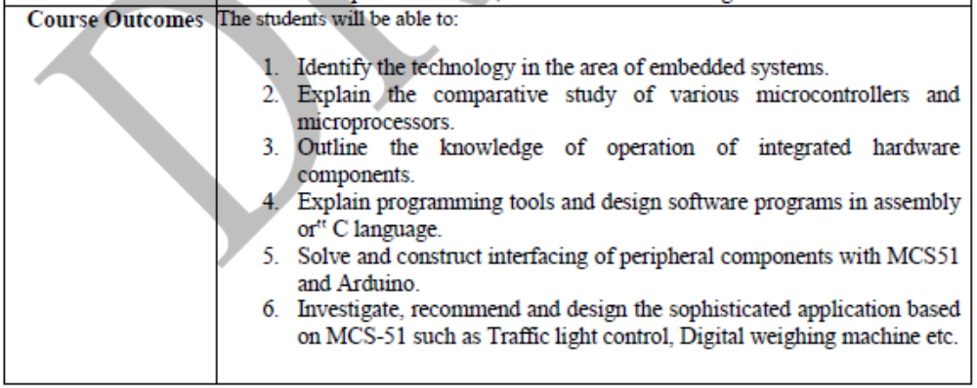

Slide 6
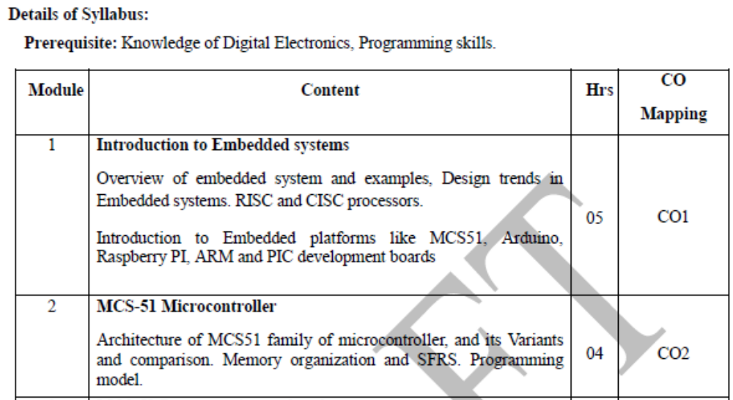

Slide 7
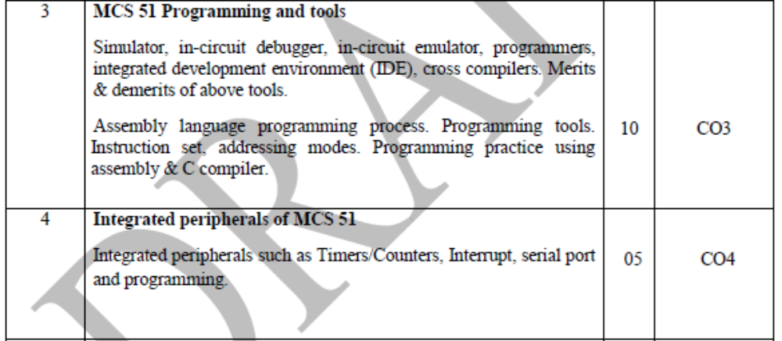

Slide 8
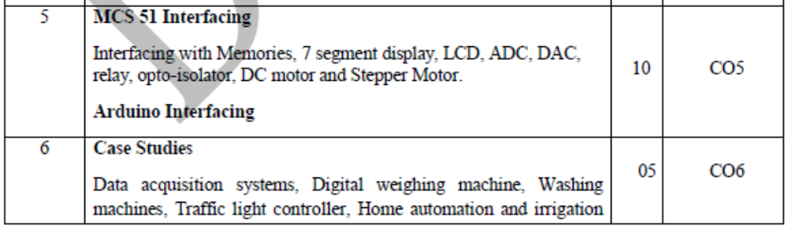

Slide 9
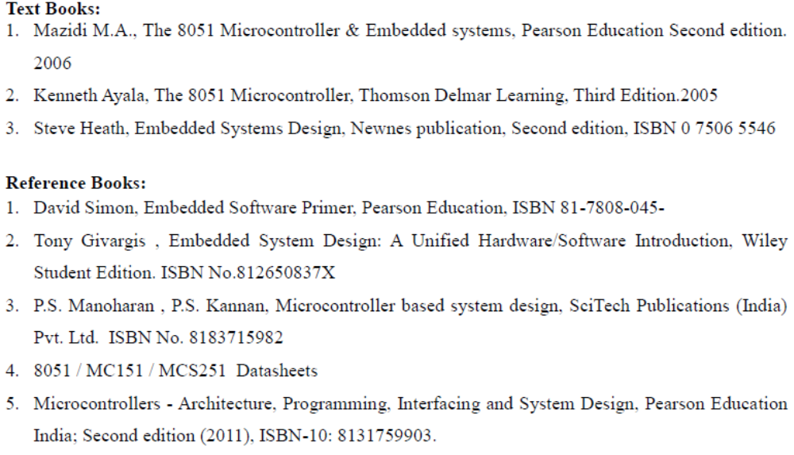

Slide 10
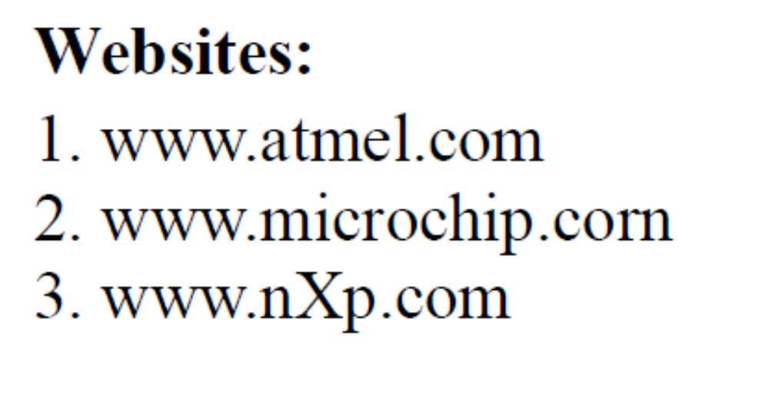

Slide 11
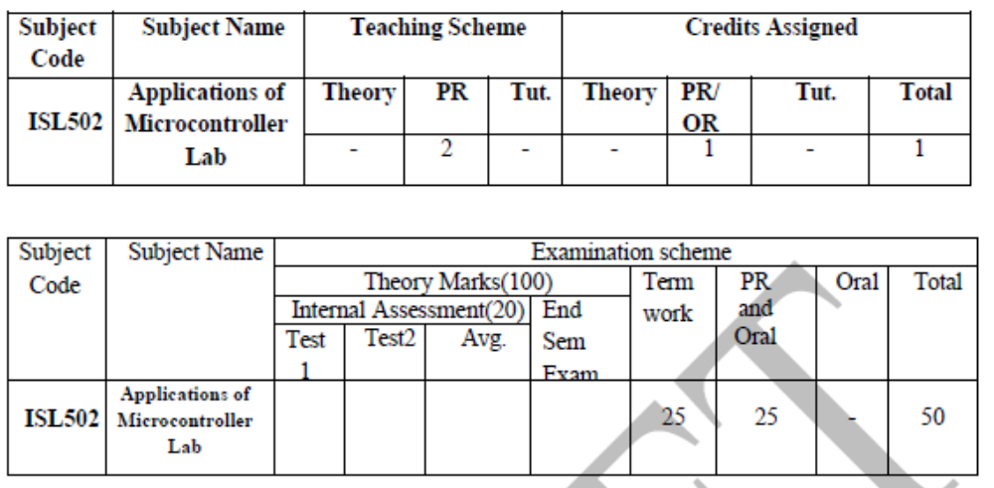

Slide 12
ISL502 | Applications of Microcontroller Lab Practice
ISL502.1 | Develop software programs using instructions learned from instruction set in assembly.
ISL502.2 | Develop software programs in embedded C language.
ISL502.3 | Construct interfacing of peripheral components with MCS 51.
ISL502.4 | Design the sophisticated application based on MCS-51 such as Traffic light control, Digital weighing machine.

Slide 13
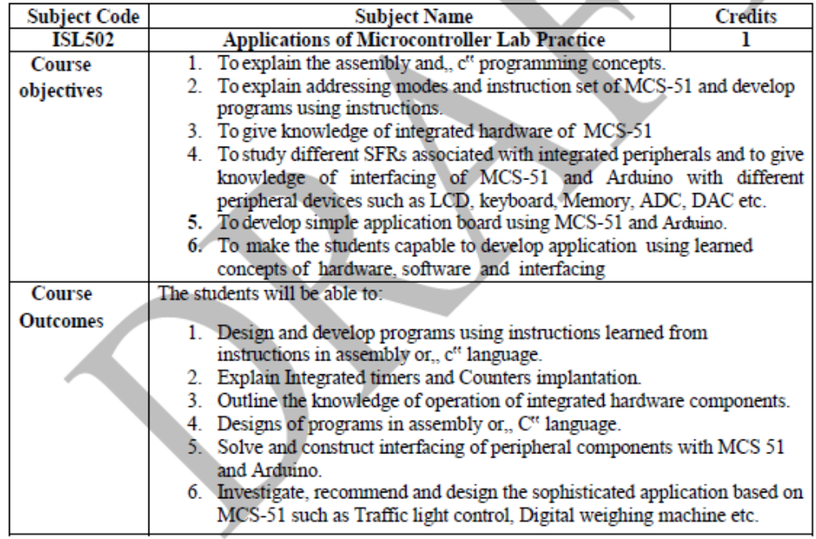

Slide 14
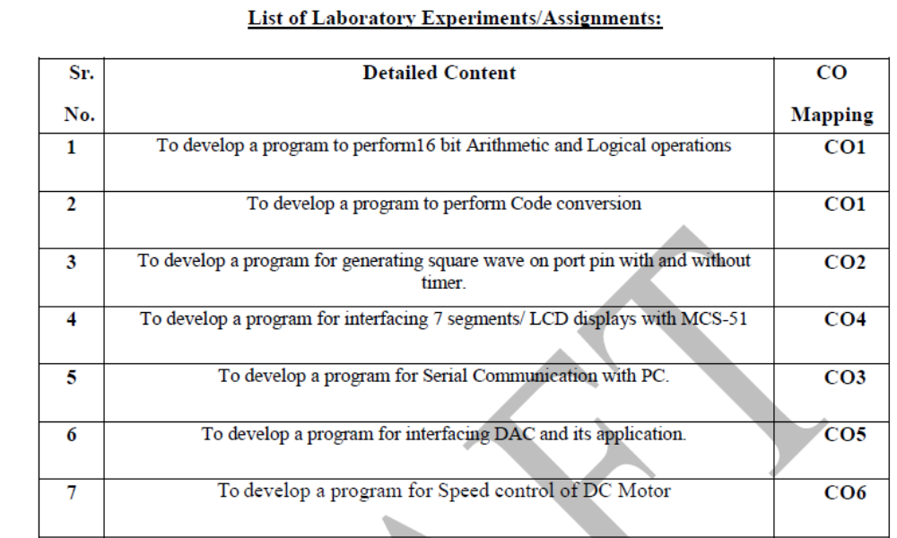

Slide 15
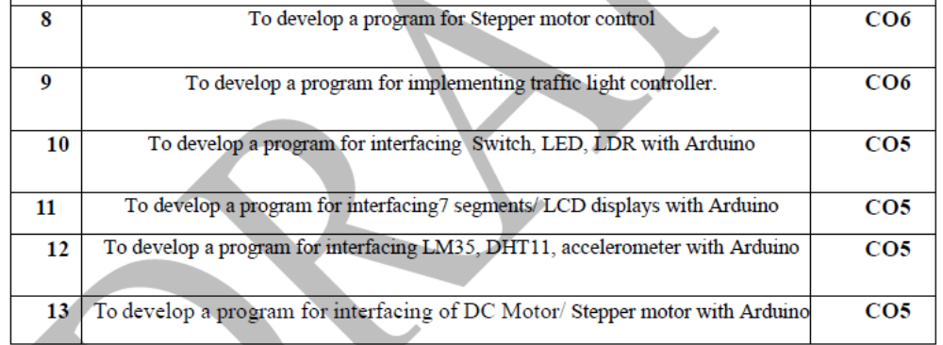

Slide 16
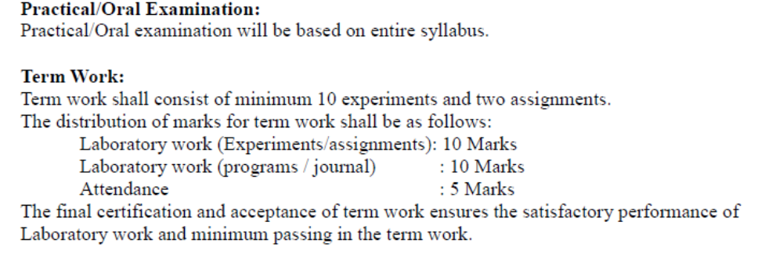

Slide 17
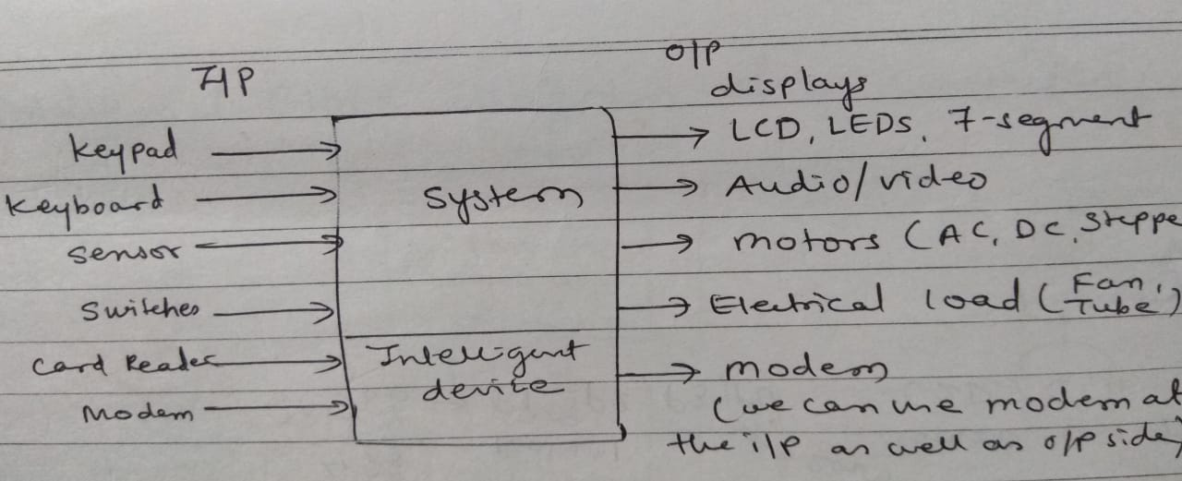
System

Slide 18
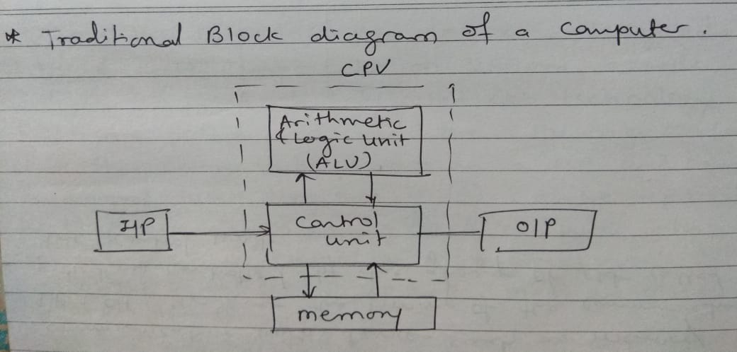

Slide 19
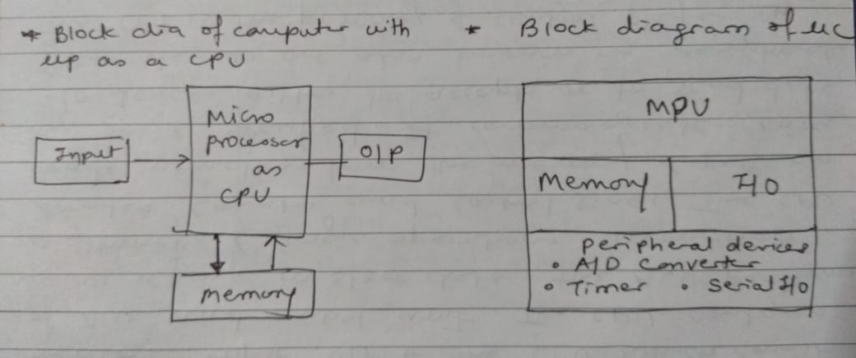

Slide 20
Embedded System
An Embedded system is a special purpose computer which is used inside a device. Embedded systems are basically a combination of hardware and software designed to perform a specific function.
Features
They compute results in real time without delay
Use little power
Low cost
Small in size

Slide 21
Embedded systems Classification
Embedded systems are classified into four categories based on their performance and functional requirements:
Stand alone embedded systems.
Real time embedded systems.
Networked embedded systems.
Mobile embedded systems.

Slide 22
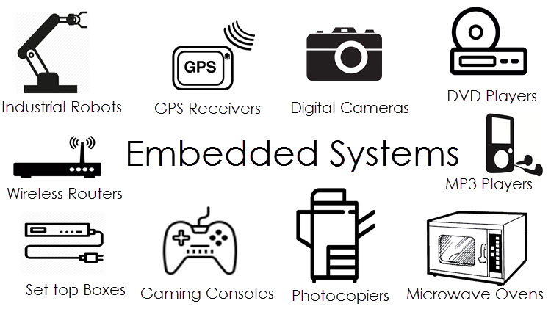

Slide 23
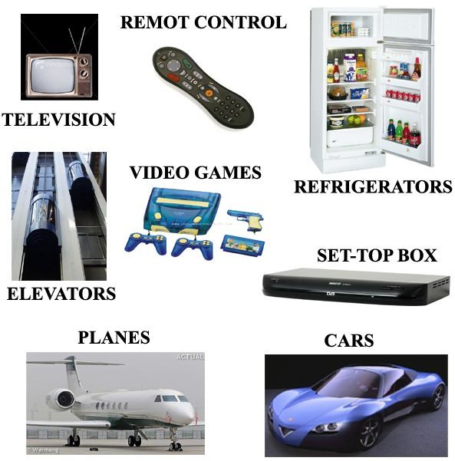

Slide 24
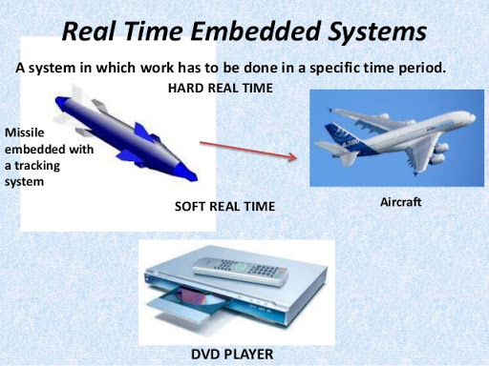

Slide 25
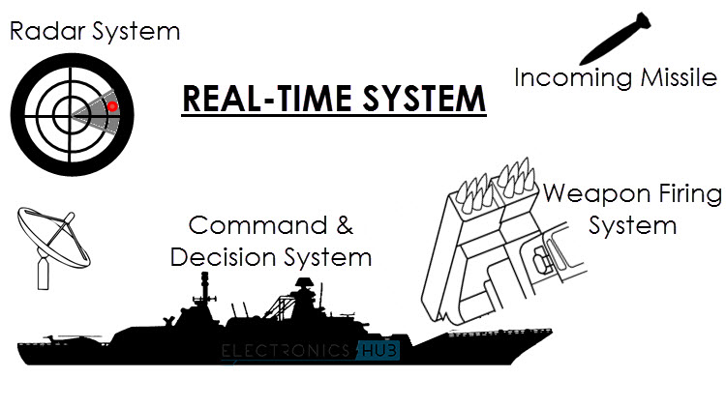

Slide 26

Real Time Operating System
An operating system (OS) is system software that manages computer hardware, software resources, and provides common services for computer programs.
A real-time operating system (RTOS) is an operating system (OS) intended to serve real-time applications immediately.
Common example of RTOS is Embedded system in Aircraft.

Slide 27
Top Recruiters in Embedded System Domain

Slide 28
